Slide 1
White-Box Testing Techniques
Software Testing and Verification
Prepared by
Stephen M. Thebaut, Ph.D.
University of Florida

Slide 2
White-Box Testing Techniques
Software Testing and Verification

Slide 3
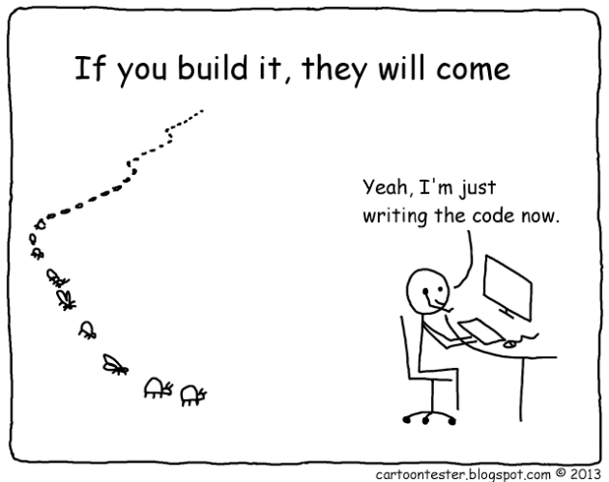

Slide 4
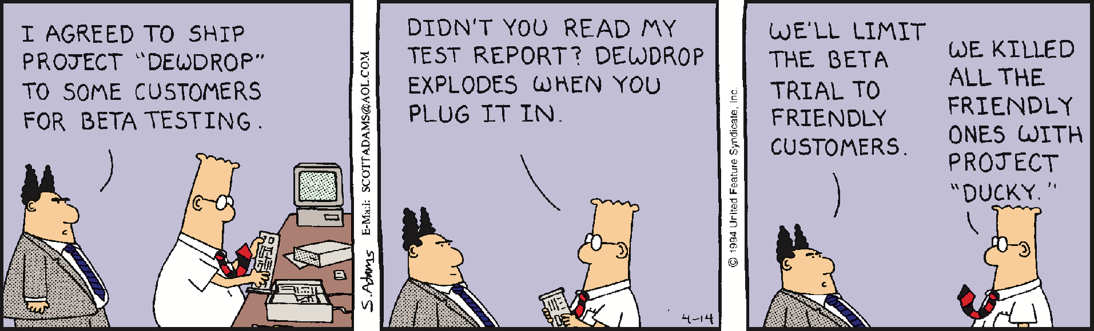

Slide 5
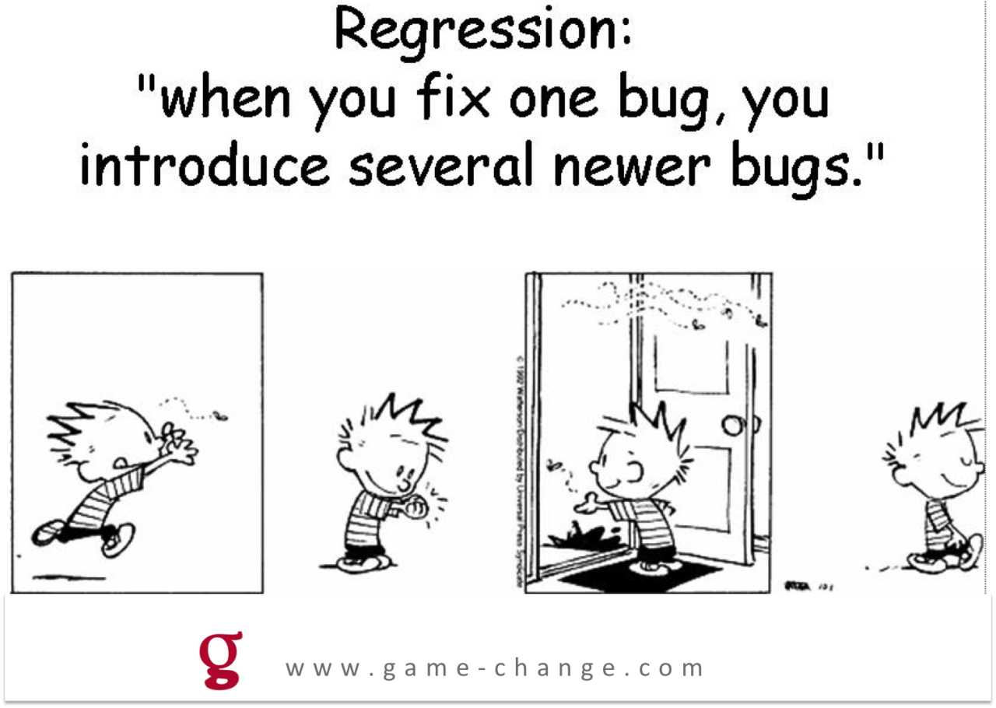

Slide 6


Slide 7
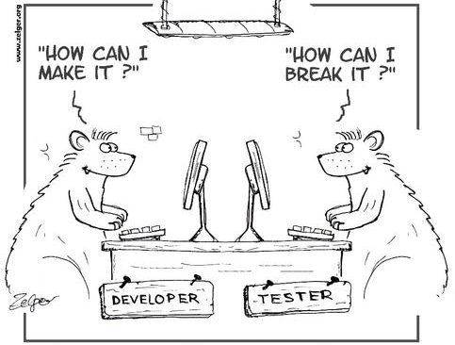

Slide 8
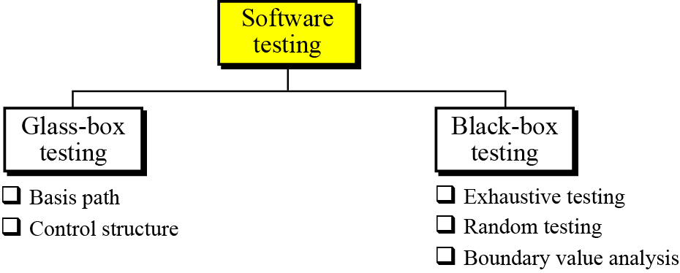
TESTING PHASE
The goal of the testing phase is to find errors, which means that a good testing strategy is the one that finds most errors. There are two types of testing: glass-box and black-box
Software testing

Slide 9
Design of Test Cases
Two main approaches to design test cases:
  Black-box approach
  White-box (or glass-box) approach

Slide 10
Black-box Testing
Test cases are designed using only functional specification of the software:
  without any knowledge of the internal structure of the software.
For this reason, black-box testing is also known as functional testing.

Slide 11
White-box Testing
Designing white-box test cases:
  requires knowledge about the internal structure of software.
  white-box testing is also called structural testing.

Slide 12
Black-box Testing
Two main approaches to design black box test cases:
  Equivalence class partitioning
  Boundary value analysis

Slide 13
White-Box Testing
There exist several popular white-box testing methodologies:
  Statement coverage
  branch coverage
  path coverage
  condition coverage
  mutation testing
  data flow-based testing

Slide 14
Design of Test Cases
Testing a system using a large number of randomly selected test cases:
  does not mean that many errors in the system will be uncovered.
Consider an example:
  finding the maximum of two integers x and y.

Slide 15
Design of Test Cases
If (x>y) max = x;
else max = x;
The code has a simple error:
test suite {(x=3,y=2);(x=2,y=3)} can detect the error,
a larger test suite {(x=3,y=2);(x=4,y=3); (x=5,y=1)} does not detect the error.

Slide 16
Definition of White-Box Testing
Testing based on analysis of internal logic (design, code, etc.). (But expected results still come from requirements.)
Also know as structural testing.
White-box testing concerns techniques for designing tests; it is not a level of testing.
White-box testing techniques apply primarily to lower levels of testing (e.g., unit and component).

Slide 17
Types of Logic Coverage
Statement: each statement executed at least once
Branch: each branch traversed (and every entry point taken) at least once
Condition: each condition True at least once and False at least once
Branch/Condition: both Branch and Condition coverage achieved

Slide 18
Types of Logic Coverage (cont’d)
Compound Condition: all combinations of condition values at every branch statement covered (and every entry point taken)
Path: all program paths traversed at least once

Slide 19
Pseudocode and Control Flow Graphs
input(Y)
if (Y<=0) then
Y := −Y
end_if
while (Y>0) do
input(X)
Y := Y-1
end_while
“nodes”
“edges”

Slide 20
Statement Coverage
Statement Coverage requires that each statement will have been executed at least once.
Simplest form of logic coverage.
Also known as Node Coverage.

Slide 21
Write test cases such that all statemements are covered
input(Y)
if (Y<=0) then
Y := −Y
end_if
while (Y>0) do
input(X)
Y := Y-1
end_while

Slide 22
Write test cases to get 100% Statement Coverage
areTheyPositive(int x, int y)
{
if (x >= 0)
print(“x is positive”);
else
print(“x is negative”);
if (y >= 0)
print(“y is positive”);
else
  print(“y is negative”);
}
Following test set will give us statement
coverage:
T₁ = {(x=12,y=5), (x= −1,y=35),
(x=115,y=−13),(x=−91,y= −2)}
There are smaller test cases which will
give us statement coverage too:
T₂ = {(x=12,y= − 5), (x= −1,y=35)}
There is a difference between these two
test sets though

Slide 23
Branch Coverage
Branch Coverage requires that each branch will have been traversed, and that every program entry point will have been taken, at least once.
Also known as Edge Coverage.

Slide 24
Branch Coverage (cont’d)
every program entry point will have been taken, at least once.”

Slide 25
Branch Coverage (cont’d)
What is the relationship between Statement and Branch Coverage?

Slide 26
Branch Coverage (cont’d)
What is the relationship between Statement and Branch Coverage?
Possible relationships:
None.
Statement Coverage subsumes Branch Coverage (“statement => branch”).
Branch Coverage subsumes Statement Coverage (“branch => statement”).

Slide 27
Does “branch => statement” ???
Normally, YES…

Slide 28
Does “branch => statement” ???
Normally, YES… in the absence of “DEAD CODE”.
DEAD CODE is not reachable via any executable program path.

Slide 29
Does “branch => statement” ???
If a program has "dead (i.e., unreachable) code", then "statement coverage" is unachievable. (We would need to modify the program in order to bring the dead code back to “life”.)
Bottom line: we will always assume the nominal case of “no dead code" unless explicitly stated otherwise. Under this assumption, Branch Coverage does indeed subsume Statement Coverage.

Slide 30
Does “Statement => branch” ???
If NO then provide a supporting example

Slide 31
Statement vs. Branch Coverage
assignAbsolute(int x)
{
if (x < 0)
x := -x;
z := x;
}
Consider this program segment, the test set
T = {x=−1} will give statement coverage,
however not branch coverage
B0
Control Flow Graph:
(x < 0)
true
false
B1
Test set {x=−1} does not
execute this edge, hence, it
does not give branch coverage
x := -x
B2
z := x

Slide 32
assignAbsolute(int x)
{
if (x < 0)
x := -x;
z := x;
}
B0
(x < 0)
true
false
B1
Test set {x=−1} does not
execute this edge, hence, it
does not give branch coverage
Test set {x= −1, x=2}gives
both statement and branch
coverage
x := -x
B2
z := x

Slide 33
Condition Coverage
A branch predicate may have more than one condition.
input(X,Y)
if (Y<=0) or (X=0) then
Y := -Y
end_if
while (Y>0) and (not EOF) do
input(X)
Y := Y-1
end_while

Slide 34
Condition Coverage (cont’d)
Condition Coverage requires that each condition will have been True at least once and False at least once.
What is the relationship between Branch and Condition Coverage?

Slide 35
Condition Coverage (cont’d)
if A or B then
s1
else
s2
end_if_then_else
 | A | B | Branch
test 1 | T | F | true
test 2 | F | F | false

Slide 36
Condition Coverage (cont’d)
if A or B then
s1
else
s2
end_if_then_else
 | A | B | Branch
test 3 | T | F | true
test 4 | F | T | true

Slide 37
Condition Coverage
something(int x)
{
if (x < 0 || y < x)
{
y := -y;
x := -x;
}
z := x;
}
T = {(x=−1, y=1), (x=1, y=1)}
Branch coverage ?
Statement coverage ?
Condition coverage ?
B0
T = {(x=−1, y=1), (x=1, y=0)}
What about this test case ?
(x < 0 || y < x)
true
false
B1
y := -y;
x := -x;
Control Flow Graph
B2
z := x
T = {(x=−1, y=−2), {(x=1, y=1)}
What about this test case ?

Slide 38
Condition Coverage
something(int x)
{
if (x < 0 || y < x)
{
y := -y;
x := -x;
}
z := x;
}
T = {(x=−1, y=1), (x=1, y=1)} will achieve
statement, branch coverage, however T will not achieve condition coverage because the boolean term (y < x) never evaluates to true.
B0
T = {(x=−1, y=1), (x=1, y=0)}
will not achieve condition coverage either. It does not achieve branch coverage since both test cases take the true branch
(x < 0 || y < x)
true
false
B1
y := -y;
x := -x;
Control Flow Graph
B2
z := x
T = {(x=−1, y=−2), {(x=1, y=1)}
achieves condition coverage.

Slide 39
Branch/Condition Coverage
Branch/Condition Coverage requires that both Branch AND Condition Coverage will have been achieved.
Therefore, Branch/Condition Coverage subsumes both Branch Coverage and Condition Coverage.

